Slide 1
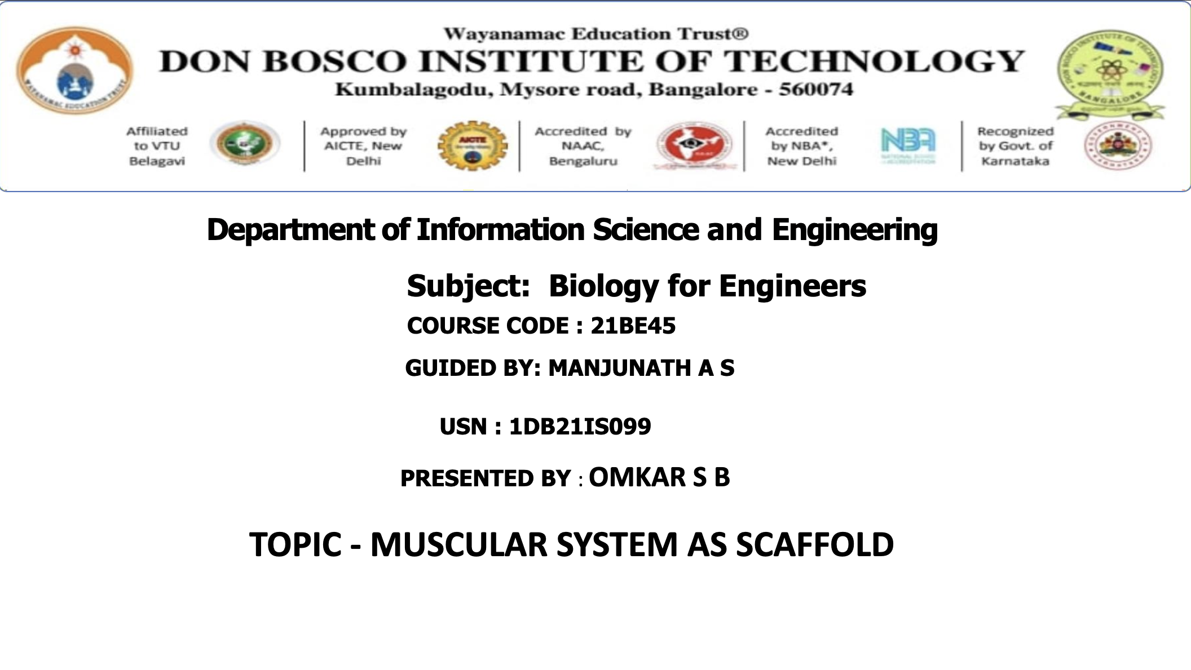

Slide 2
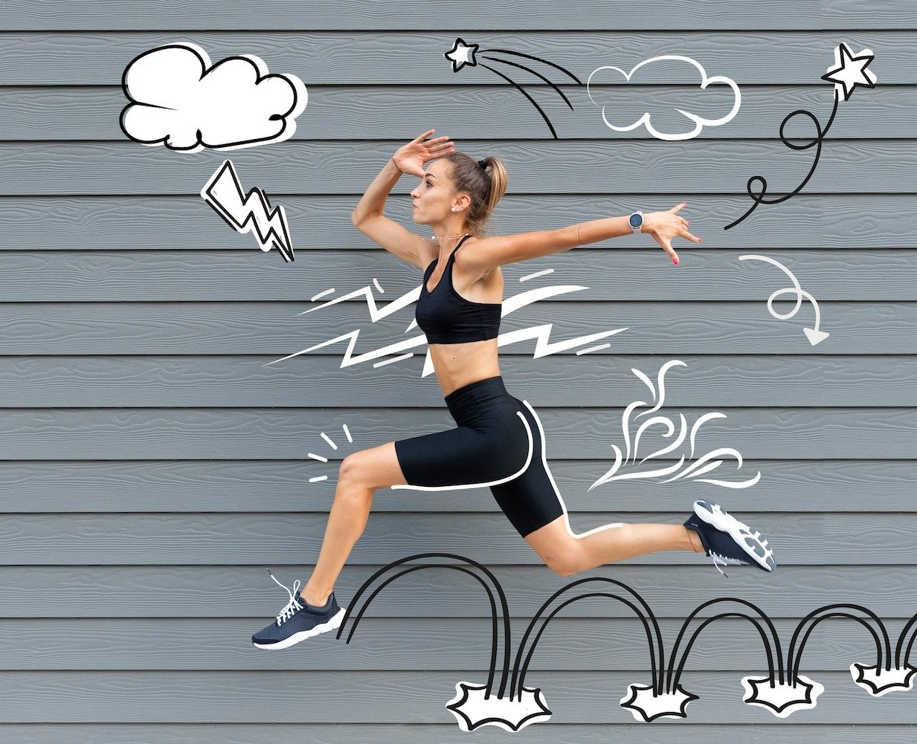
BUILDING A STRONG FOUNDATION: THE MUSCULAR SYSTEM AS A SCAFFOLD

Slide 3
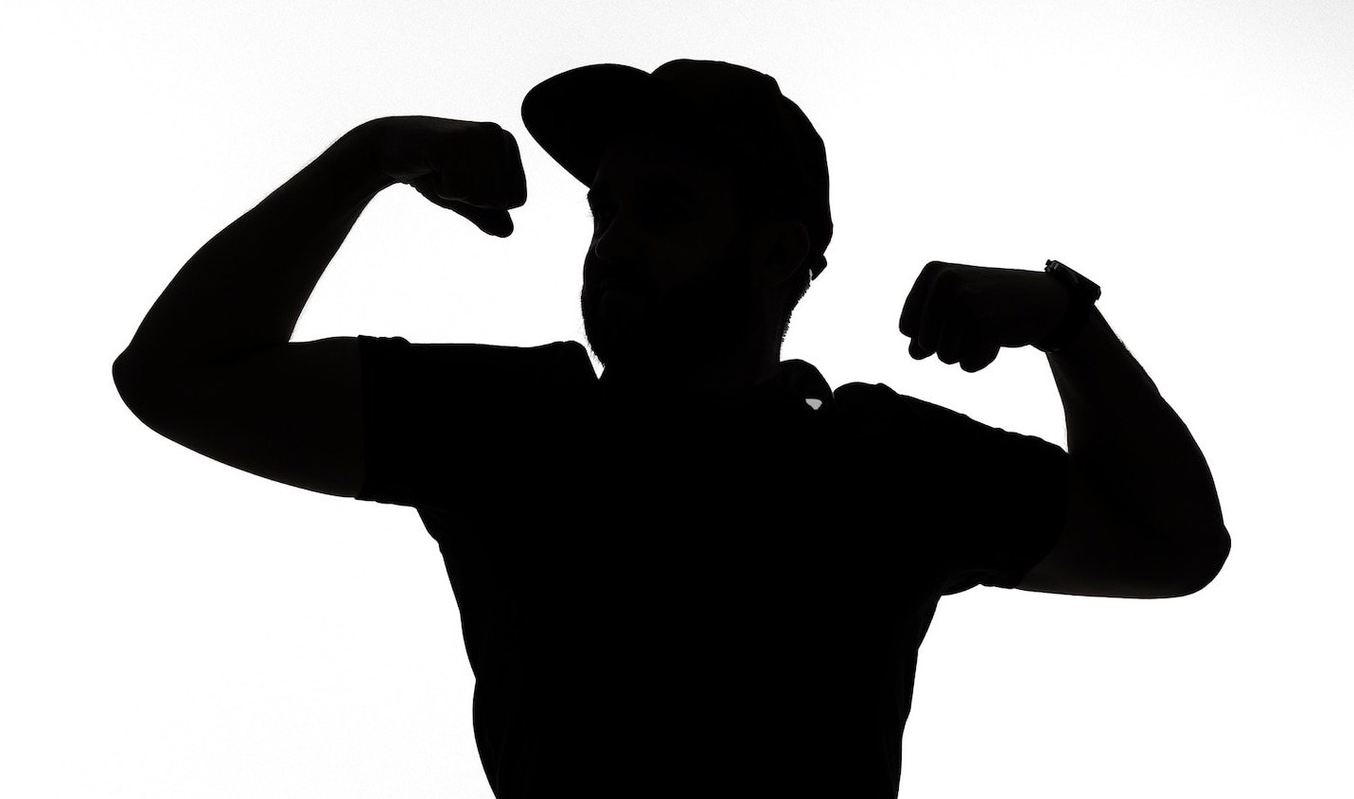
INTRODUCTION
The muscular system……is a complex network of tissues that plays a vital role in the human body.
It provides support and stability, enables movement and protects vital organs. This presentation will explore the muscular system as a scaffold for building a strong foundation.

Slide 4
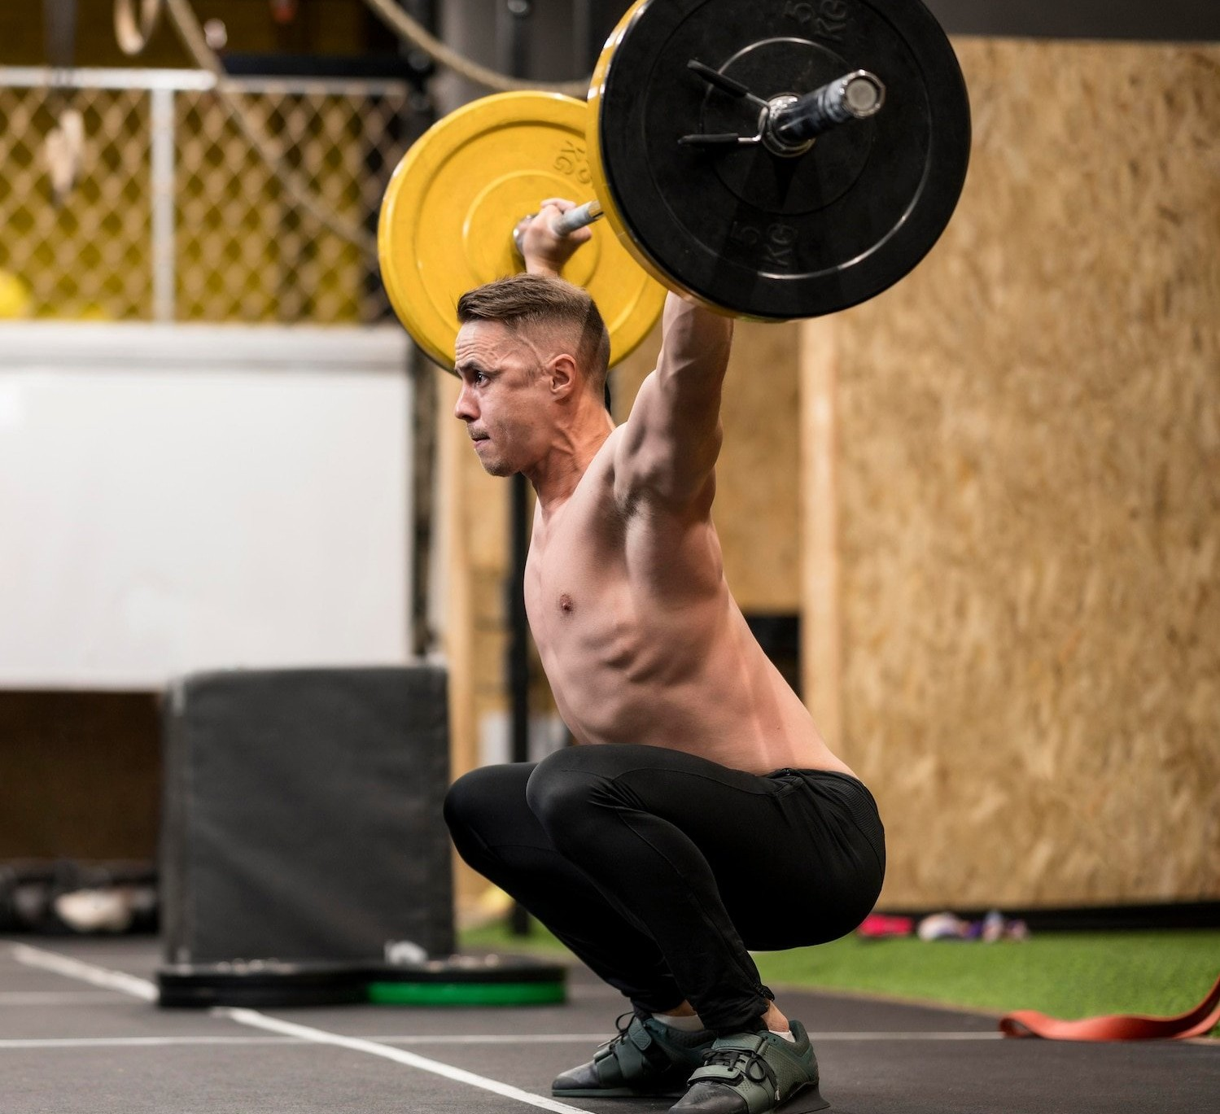
MUSCLES AND MOVEMENT
Muscles are responsible for movement in the body. They work in pairs to contract and relax, allowing for range of motion. Skeletal muscles are attached to bones by tendons, and when they contract, they pull on the bones to create movement.

Slide 5
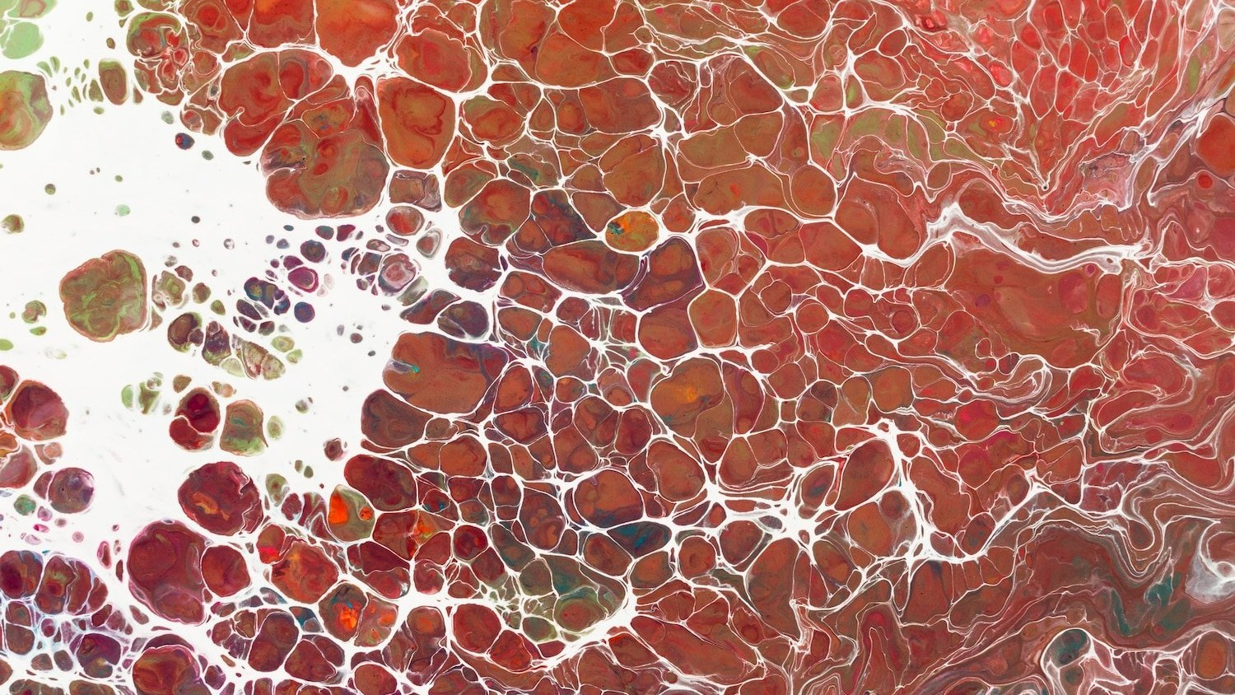
TYPES OF MUSCLES
There are three types of muscles in the body: skeletal, smooth, and cardiac. Skeletal muscles are attached to bones and are responsible for voluntary movement. Smooth muscles are found in organs and blood vessels and are responsible for involuntary movement. Cardiac muscles are found in the heart and are responsible for pumping blood throughout the body.

Slide 6
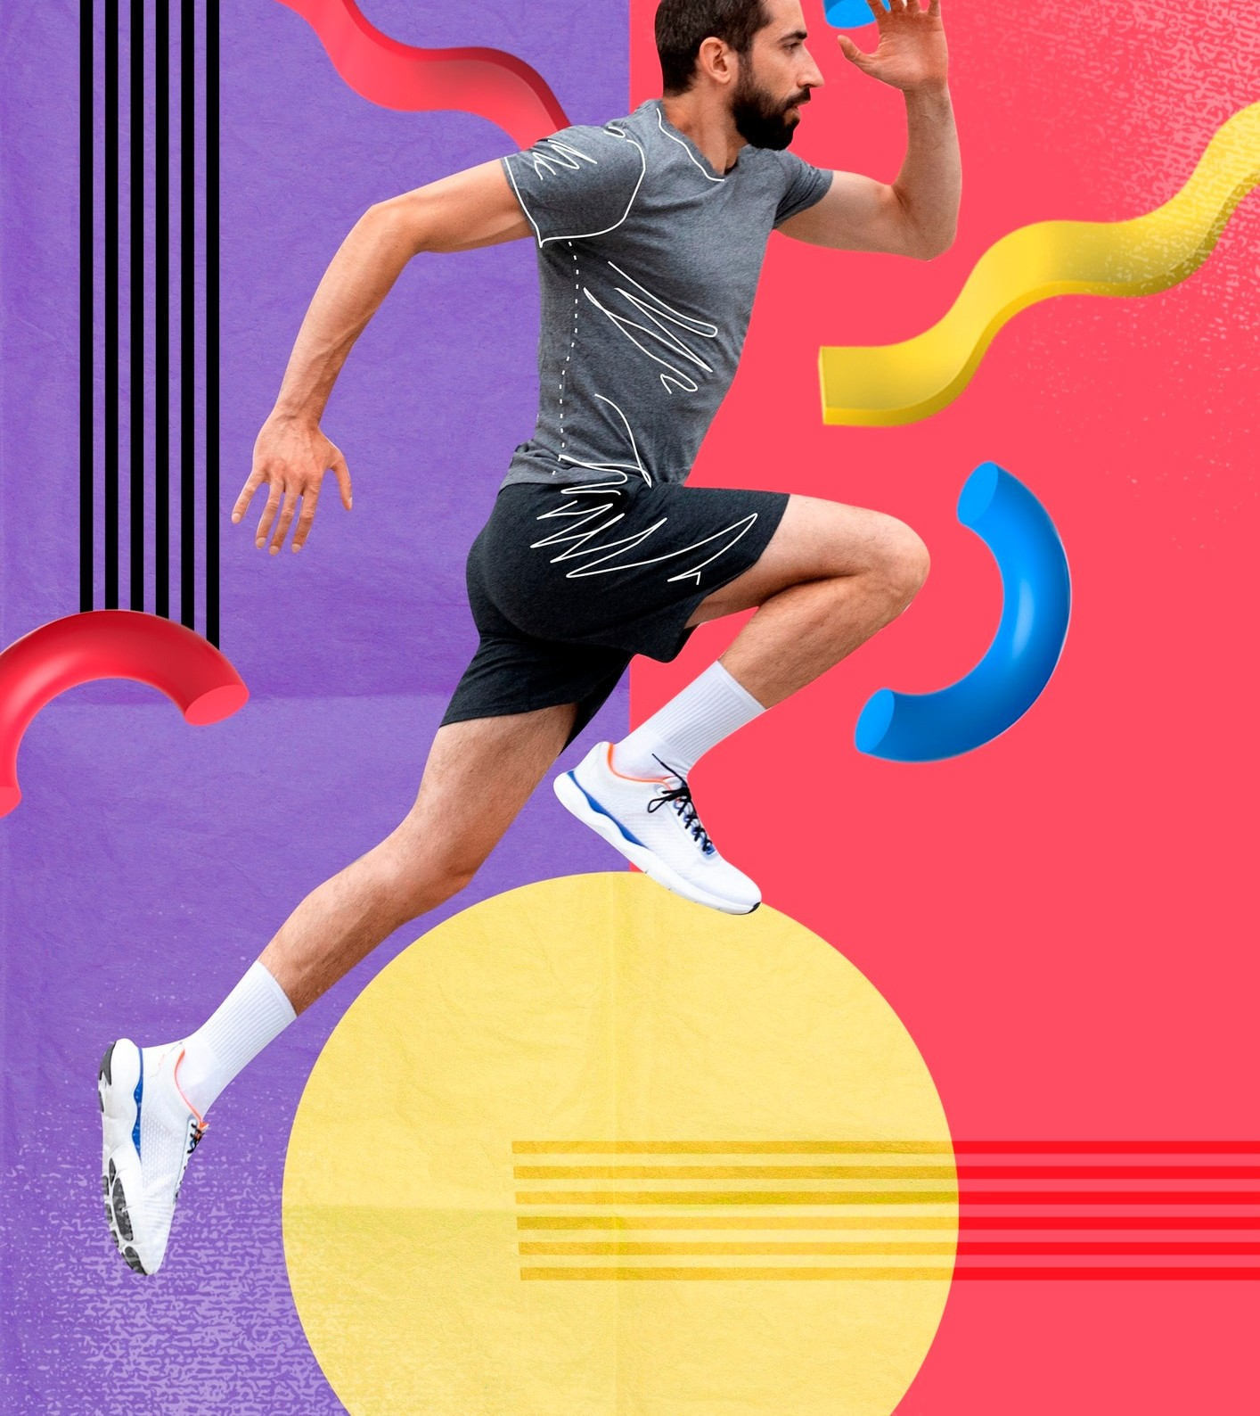
MUSCLE FIBER TYPES
There are two types of muscle ﬁbers: slow- twitch and fast-twitch. Slow-twitch ﬁbers are used for endurance activities like running long distances, while fast-twitch ﬁbers are used for explosive activities like sprinting and jumping.

Slide 7
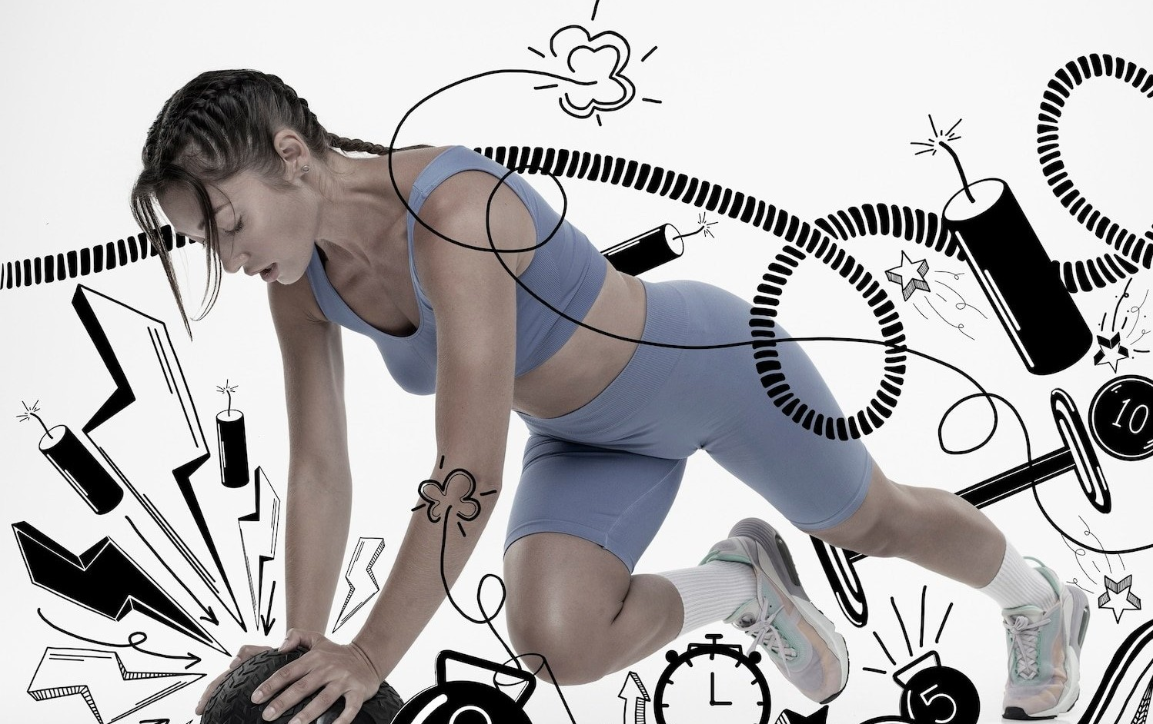
MUSCLE ADAPTATION
Muscles can adapt to the demands placed on them. Resistance training can increase muscle size and strength, while endurance training can increase the number of mitochondria in muscle cells, allowing for better energy production during long- duration activities.

Slide 8
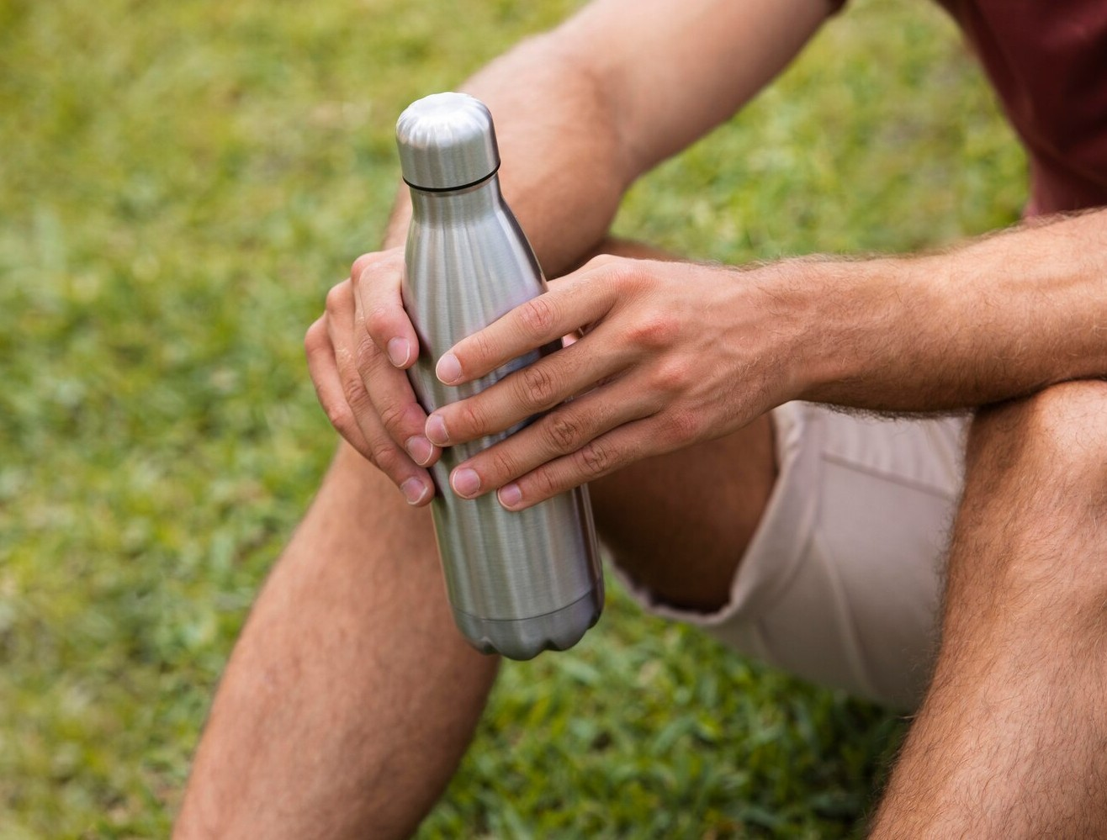
MUSCLE INJURIES
Muscles can be prone to injury, especially if they are overused or not properly warmed up. Common muscle injuries include strains and sprains. It's important to treat muscle injuries with rest, ice, compression, and elevation.

Slide 9
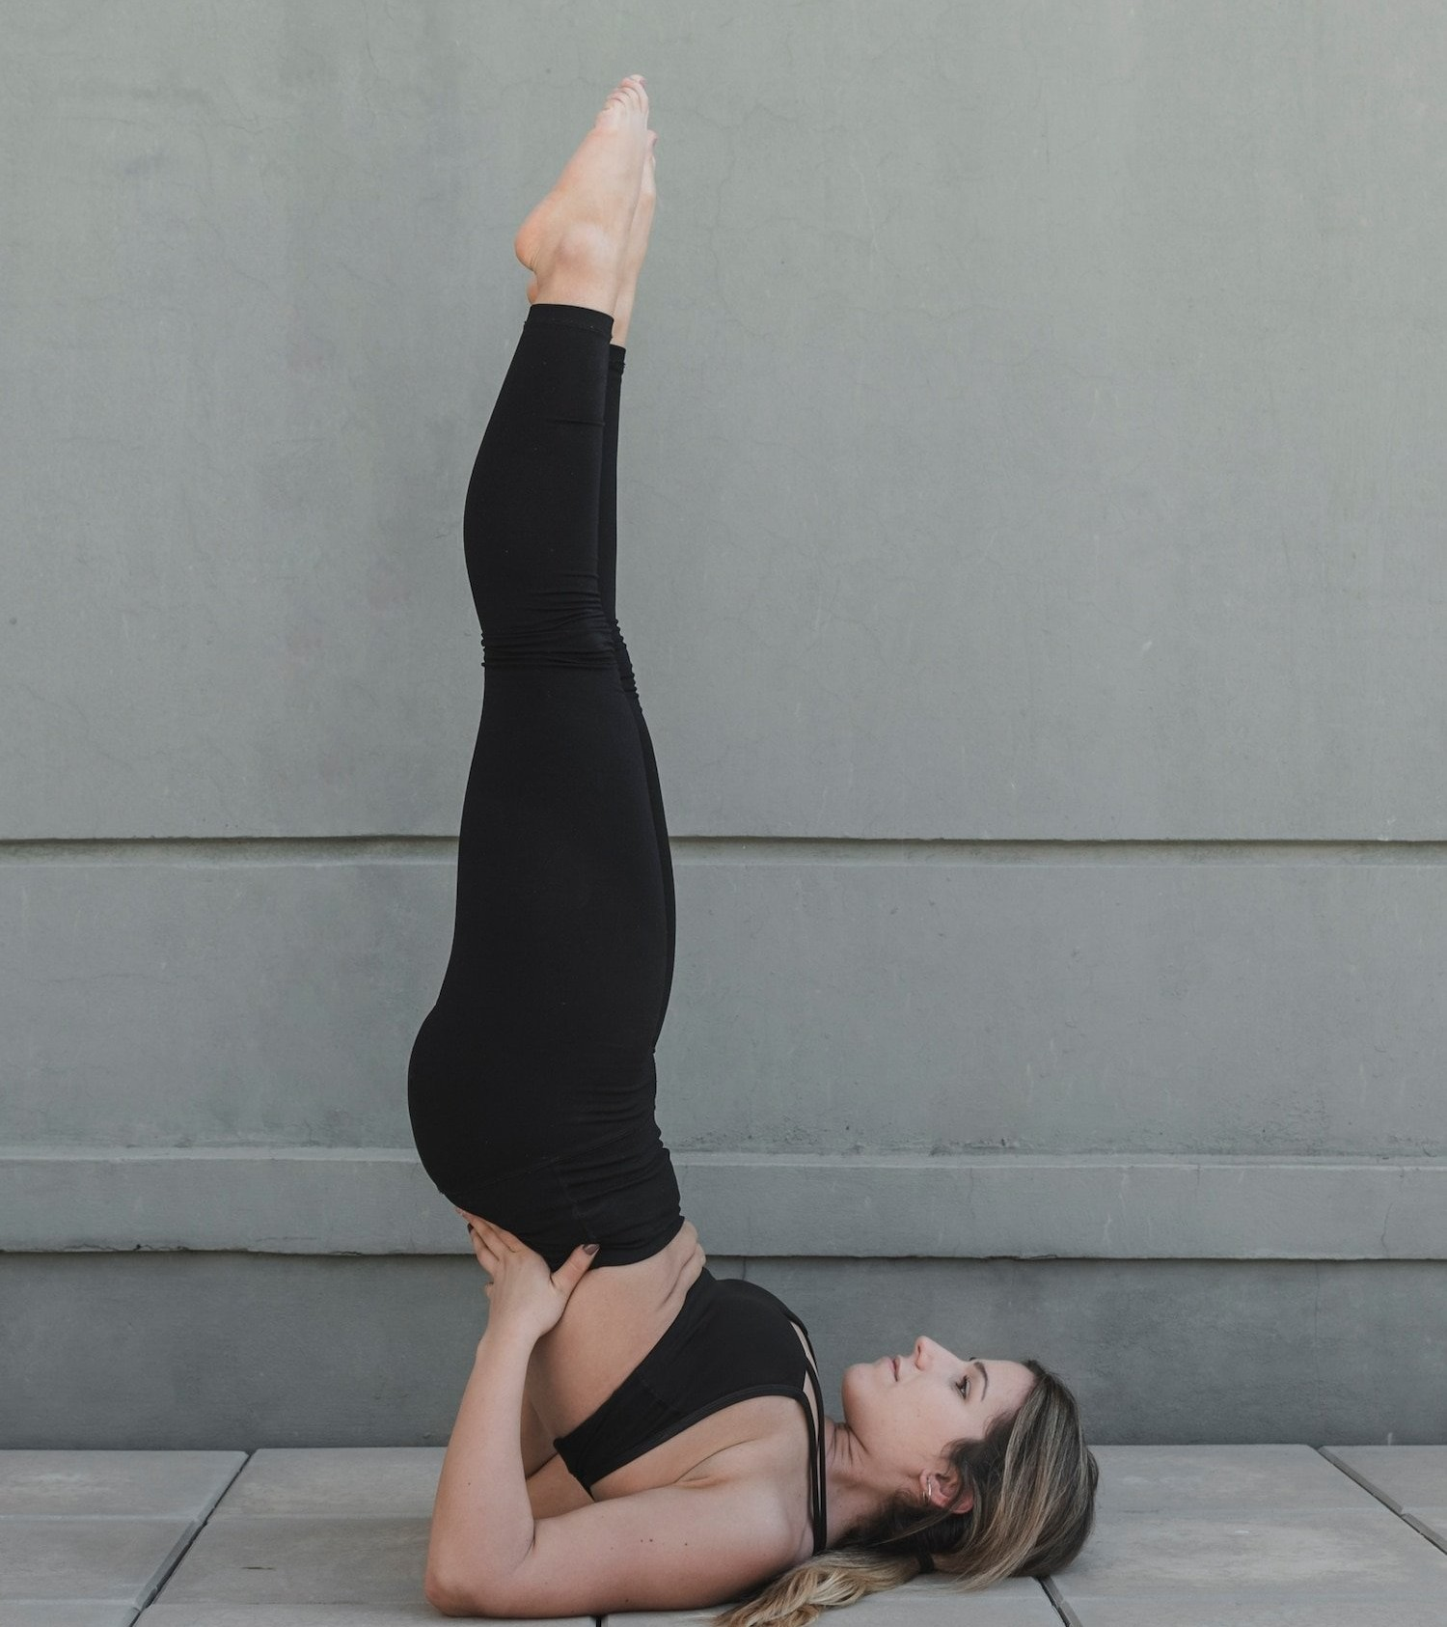
THE IMPORTANCE OF STRETCHING
Stretching is important for maintaining ﬂexibility and preventing muscle injuries. It's important to stretch before and after exercise, and to hold stretches for at least 30 seconds. Dynamic stretching, which involves movement, is best before exercise, while static stretching, which involves holding a stretch, is best after exercise.

Slide 10
CONCLUSION
The muscular system is a vital part of the human body, providing support, stability, and movement. By understanding the different types of muscles and how they work, we can build a strong foundation for our bodies.
Proper training, stretching, and injury prevention can help us maintain healthy muscles throughout our lives.

Slide 11
Thanks!

